Slide 1

BCA Ist Semester
PROBLEM SOLVING USING COMPUTER
Course Code: BCAC 0018
Presented by:
Mr. SANTOSH KUMAR SWARNKAR
Dept. Of CEA
GLA University, Mathura

Slide 2
Memory
Memory is the most essential part of a computer
Without memory there would be no computer, as we know it today.
It is used for storing both instructions to be executed and data.
Computer memory is any physical device capable of storing information temporarily or permanently.

Slide 3




Central Processing Unit
Control Unit
Output
Input Devices
ALU
Output Devices
Devices
Special Purpose Processors
Primary Storage
Secondary Storage
Devices

Slide 4



CLASSIFICATION OF MEMORY
Memory
Primary(Main
Memory)
Secondary Memory
emory

Slide 5
Primary Memory(Main Memory)
Primary Memory :-
Used to hold running program instructions.
Used to hold data, intermediate results, and results of ongoing processing of job(s).
Fast in operation
Small capacity
Expensive
Volatile(looses data on power dissipation)

Slide 6
MAIN MEMORY
TYPES
RAM
ROM

Slide 7
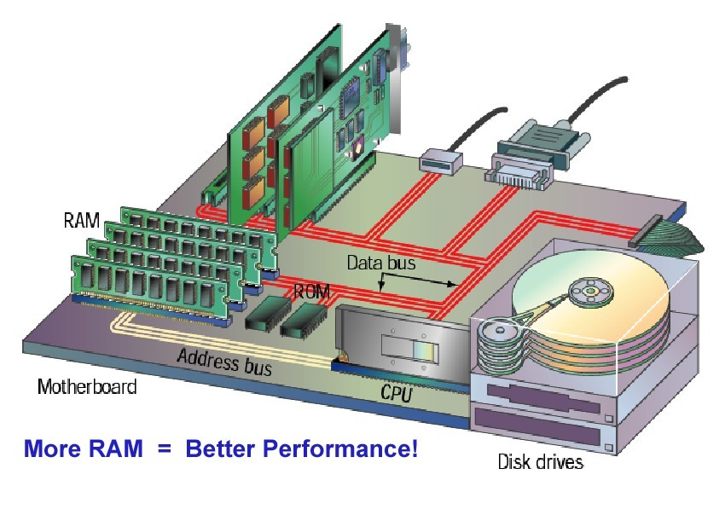

Slide 8
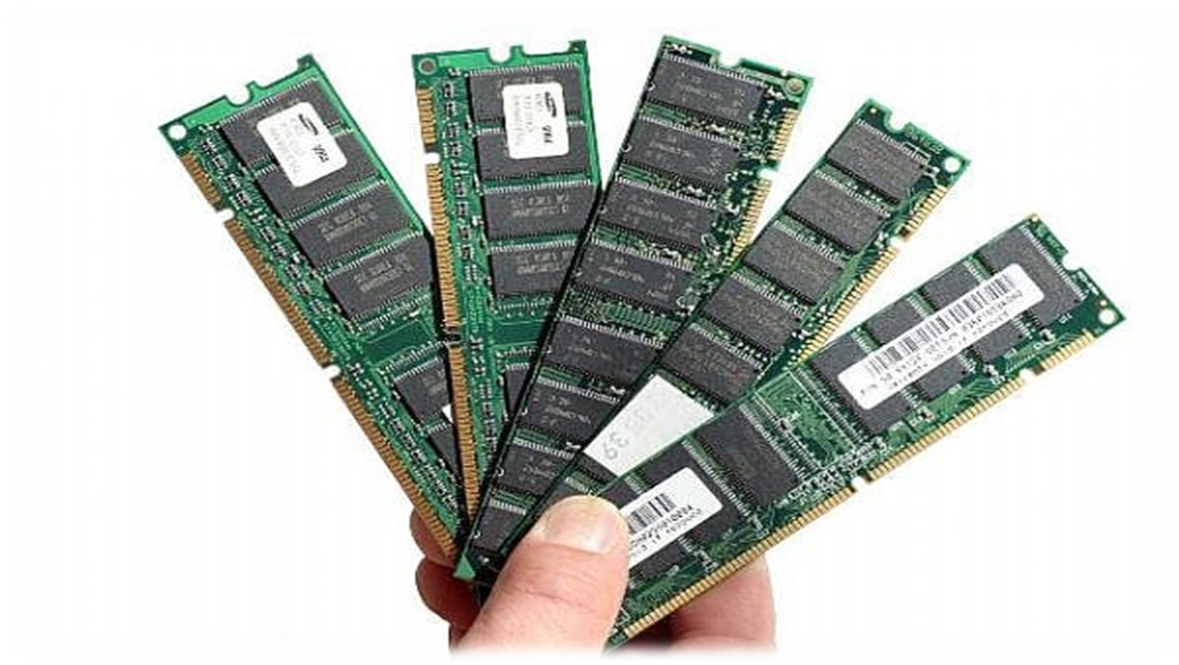




RANDOM ACCESS MEMORY
A RAM memory chip is an integrated circuit (IC) made of millions of transistors and capacitors.
Dynamic RAM
Static RAM
RAM

Slide 9

The RAM chips are of two types-
◻
Dynamic RAM(DRAM)
A form of volatile memory which also requires the stored information to be periodically re-read and re-written, or refreshed, otherwise it would vanish.
Static RAM (SRAM)
A form of volatile memory similar to DRAM with the exception that it never needs to be refreshed.

Slide 10

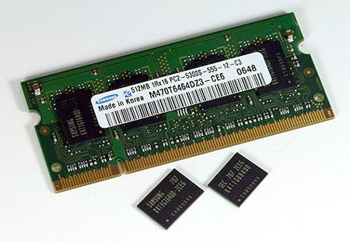
◻
A type of RAM that stores each bit of data in a separate capacitor within an integrated circuit.

Slide 11

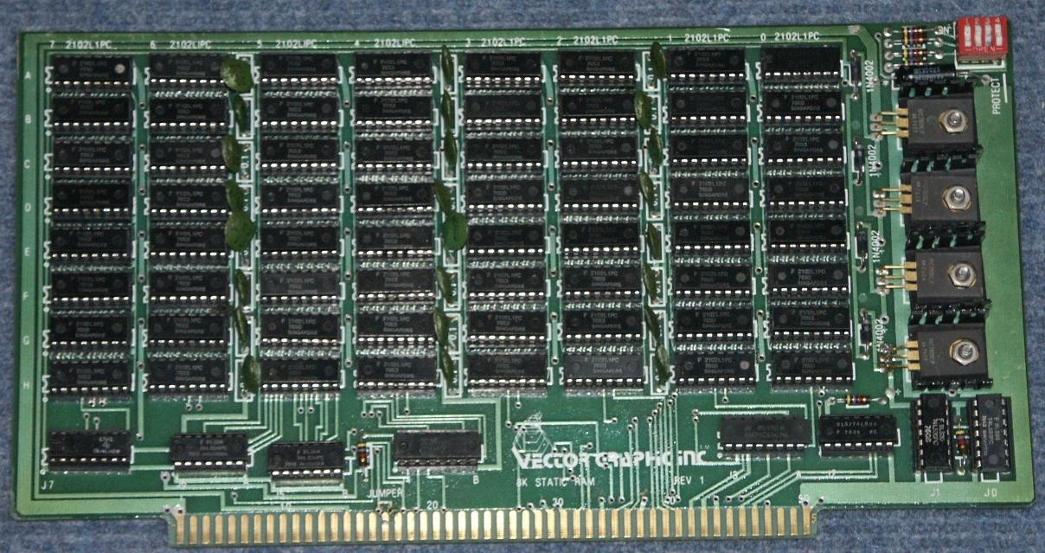
It is a type of memory in which, memory refreshing is not required.
◻
◻
It uses flip-flops to store binary information.

Slide 12

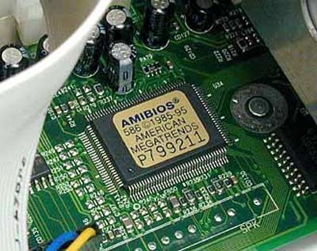
It performs only read function not write function. So the data stored in ROM cannot be modified.
It comes with special internal electronic fuses that can be programmed for a specific configuration.
Once this pattern is established it stays in the unit. Thus, ROM is non-volatile memory.

Slide 13

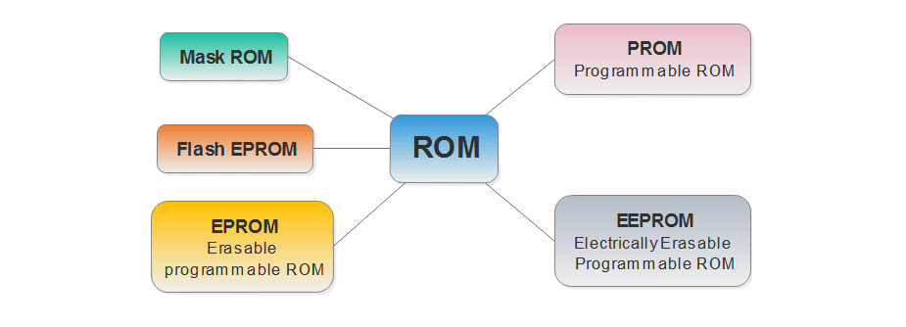

Slide 14
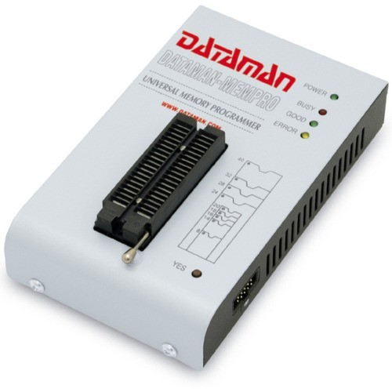
1. PROGRAMMABLE READ-ONLY MEMORY (PROM)
PROM: Programmable ROM, or PROM, is essentially a blank version of ROM that you can purchase and program once with the help of a special tool called a programmer
This device uses high voltages to permanently destroy or create internal links (fuses or antifuses) within the chip.
Consequently, a PROM can only be programmed once.

Slide 15
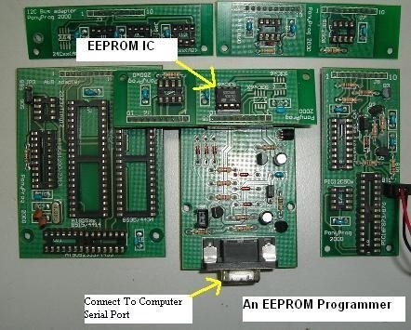
2. ELECTRICALLY ERASABLE PROGRAMMABLE READ-ONLY MEMORY (EEPROM)
It allows its entire contents (or selected banks) to be electrically erased, then rewritten electrically, so that they need not be removed from the computer (or camera, MP3 player, etc.)

Slide 16
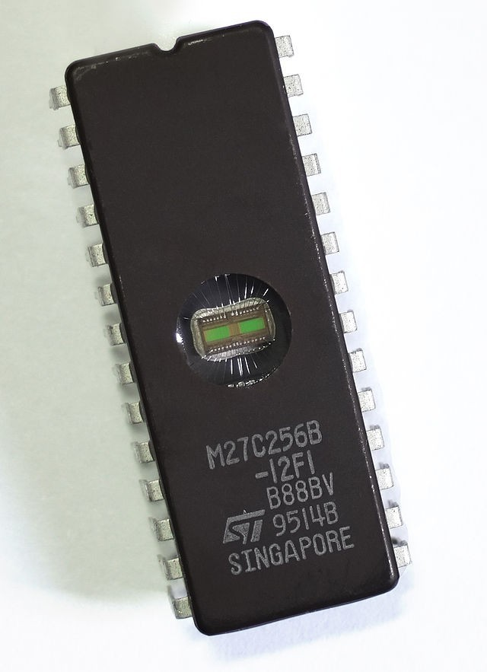
3.ERASABLE PROGRAMMABLE READ-ONLY MEMORY (EPROM)
It can be erased by exposure to
strong ultraviolet light (typically for 10 minutes or longer), then rewritten with a process that again requires application of
higher than usual voltage.

Slide 17
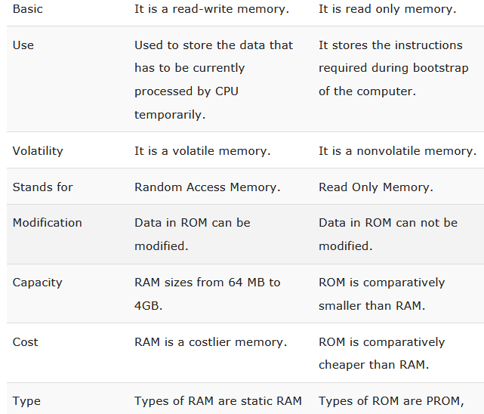
RAM VS ROM

Slide 18


